Slide 1
Social Media Guidelines
Sharing Press Mentions and Ruby Ribbon Posts
Updated June 2021

Slide 2
Why Follow Rules and Guidelines?
Increases Ruby Ribbon’s brand awareness.
Follows Ruby Ribbon’s brand voice and visual identity and shapes how others view and recall the brand.
Decreases misinformation or ambiguity.
Increases positive relationships with press members, news publications, and influencers.
Follows social platform algorithms, increasing Ruby Ribbon’s presence in searches and personal feeds.
Increases your ability to be shared and followed!

Slide 3
Latest News and Press Mentions
Follow & tag press team, Scenario - FB @scenariocommunication | IG @ourscenario
Latest press is available on Ruby Ribbon website: https://www.rubyribbon.com/Pws/homeoffice/tabs/press
US Weekly Buzz-o-meter with Kelly Clarkson Testimonial (featuring Pale Lace Cami & Turquoise Sport Tank)
Do’s
a. Share one of the corporate-approved social assets on your Facebook and Instagram feeds or take a screenshot of the article to upload to your personal post.
b. Tag @rubyribbonhq and @usweekly in post copy on Instagram.
c. Tag @Ruby Ribbon and @US Weekly in post copy on Facebook.
d. Add direct link to article in your post: https://bit.ly/3wt4tio
e. Use corporate-approved post messages in your post. OK to personalize as long as you adhere to copy guidelines:
“Love working for this amazing company. So glad our products are getting the attention they deserve!”
“So glad our products are inspiring women everywhere and thankful to work for this amazing company!”
“Woo-hoo! Ruby Ribbon is making headlines!”
f. Include the following hashtags:
In every post
#rubyribbon #rubyribbonstylist #camilife #wirefree #bodypositive #womeninbusiness #shegigs #press #review
In relevant post
#cami #sportsbra #athleisure #braalternative

Slide 4
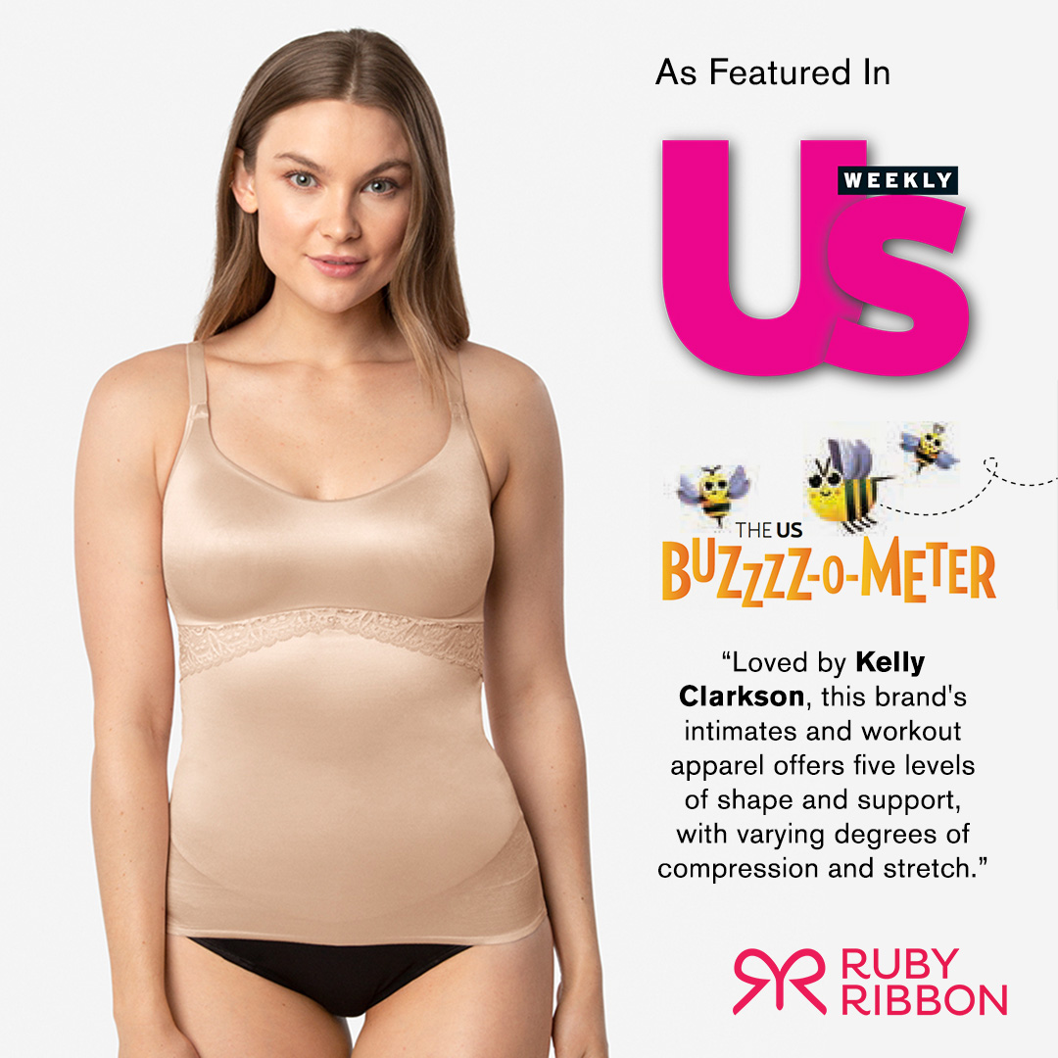
Latest News and Press Mentions
US Weekly Buzz-o-meter with Kelly Clarkson Testimonial
Don’ts
Do not tag Kelly Clarkson or any of her entertainment associations (e.g. The Voice, The Kelly Clarkson Show, etc.)
Do not paraphrase or alter this testimonial in any way. Please do not say: “Kelly Clarkson can’t live without Ruby Ribbon.” You must use corporate-provided asset or copy and paste ‘as is.’
Do not include Kelly Clarkson image in any of your communications as we do not have permission to use her likeness.
Do not include Kelly Clarkson name, image or this press testimonial in any print ads or media you may purchase as we do not have these usage rights.
Do not add personal font or text over press image or corporate-provided assets.

Slide 5
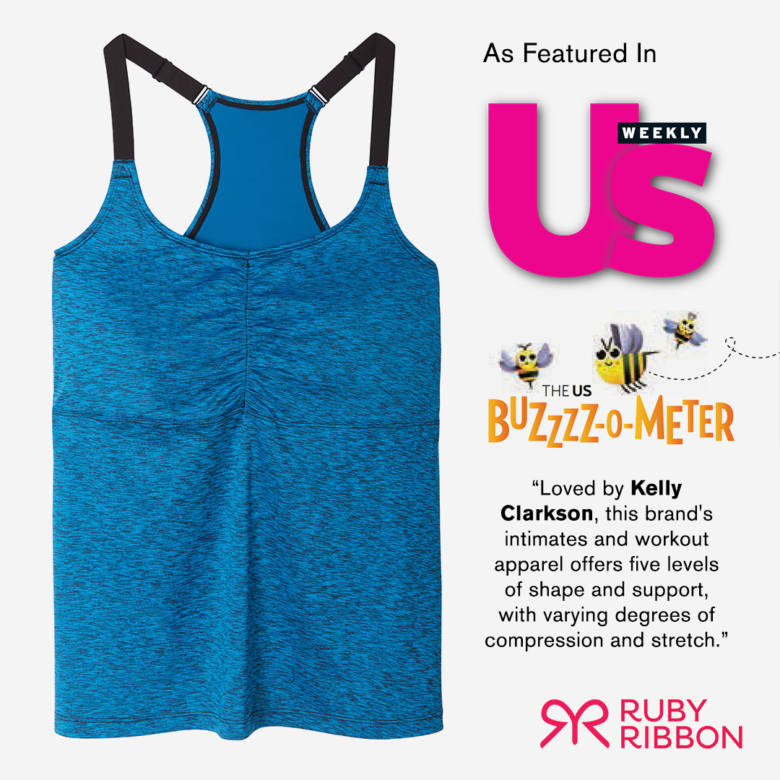
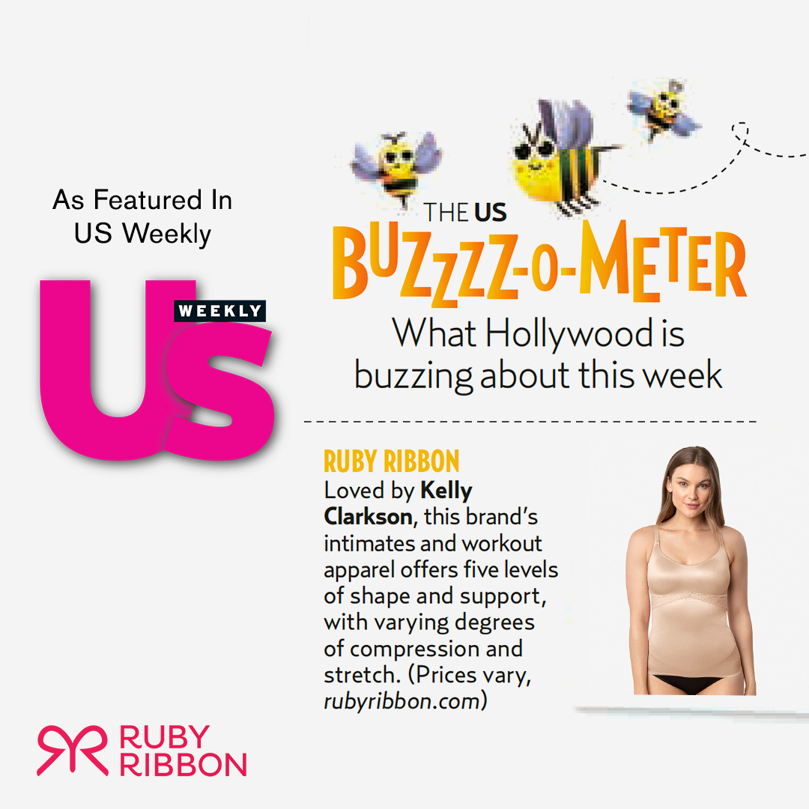
Latest News and Press Mentions

Slide 6
Latest News and Press Mentions
OK! Style Week and StarStyle inclusion of new Diva Lace cami in Coral
Tag FB @okmagazine | IG @okmagazine or
FB @starmagazine | IG @starmagazine
Tag FB @Ruby Ribbon | IG @rubyribbonhq
Use hashtags: #cami #demi #wirefree #braalternative #bodypositive #press
Link to article: http://bit.ly/3uxRI4P
Share corporate-approved social asset.

Slide 7
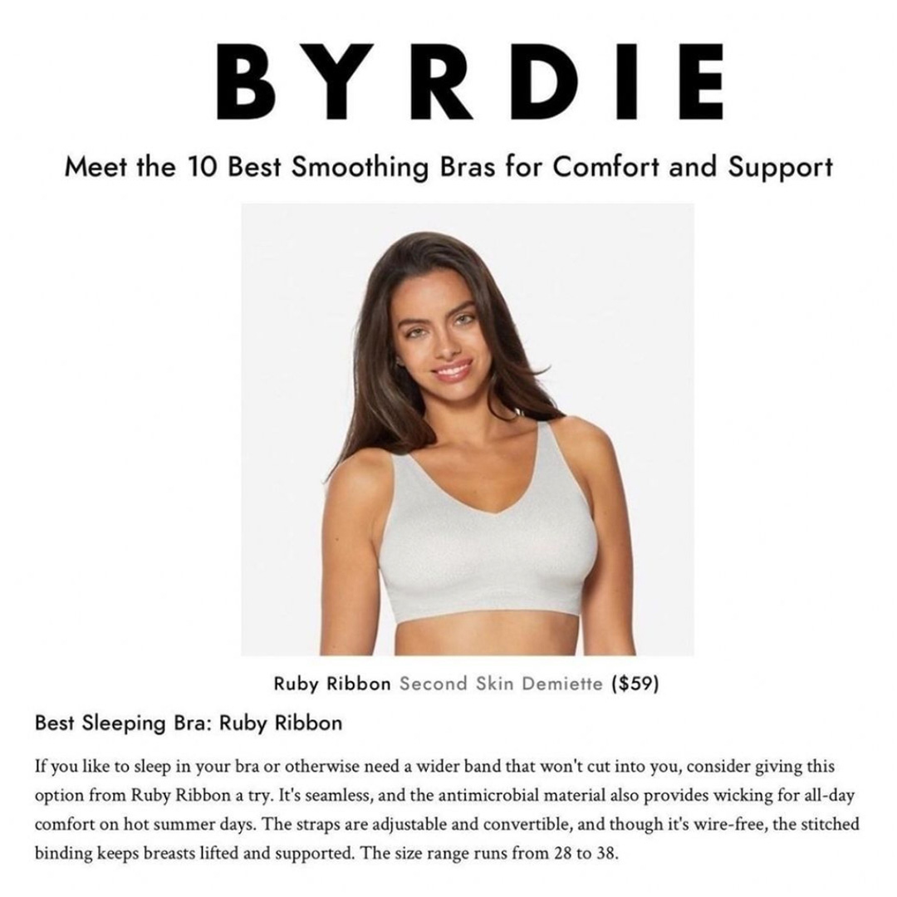
Latest News and Press Mentions
Byrdie Review of Second Skin (e.g. 10 Best Smoothing Bras for Comfort & Support, Best Sleeping Bra)
Tag FB @ByrdieBeauty | IG @byrdie
Tag FB @Ruby Ribbon | IG @rubyribbonhq
Use hashtags: #secondskin #demi #cami #wirefree #braalternative #bodypositive #press #review
Include link to article: https://bit.ly/3vCMgiw
Share corporate-approved social asset.

Slide 8
Latest News and Press Mentions
Bello Review of Allure
Tag FB @Bello Mag | IG @bellomagzine
Tag FB @Ruby Ribbon | IG @rubyribbonhq
Use hashtags: #allure #cami #demi #wirefree #braalternative #bodypositive #press
Share corporate-approved social asset.

Slide 9
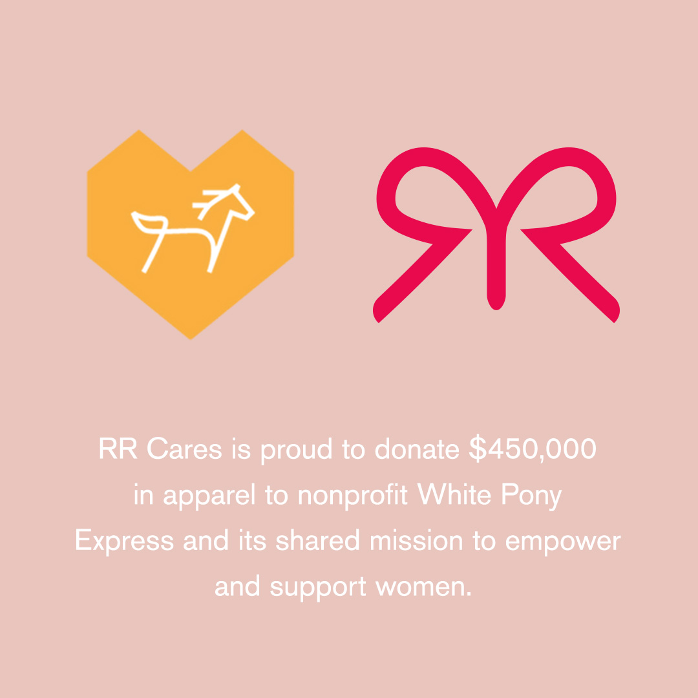
Latest News and Press Mentions
White Pony Express/RR Cares Donation
FB @whiteponyexpress | IG @whiteponyexpress
Tag FB @Ruby Ribbon | IG @rubyribbonhq
Use hashtags: #RRcares #values #donate #womensupportingwomen #community #press
Include link to article: bit.Ly/2SDNw64
Share corporate-approved social asset.

Slide 10
Improve Trending with Hashtags
To include in every post
#camilife #rubyribbon #rubyribbonstylist #wirefree #bodypositive #loveyourbody #womeninbusiness #shegigs
To include when relevant
#cami #demi #athleisure #braalternative #allure #secondskin #siren #press #review

Slide 11
Facebook Guidelines
DO
Use corporate provided assets and messaging
Share corporate social post directly, or take screenshot and copy messaging to use on personal feed.
Tag @rubyribbon in post copy.
Tag @<press outlet> in post copy.
Quote directly from the press mention, adding your own flair to the messaging to encourage follower feedback.
Use hashtags relevant to post and brand.
Add a direct link to the article when possible.
Include specific product name and how to order on your website.
DO NOT
Include "claims" that cannot be made (e.g. no doctoring of press or celebrity testimonials), and additions/alterations that cannot be made.
Miss an opportunity to show on searches by not including hashtags or tagging publications.
Comment with negative feedback. Please contact corporate directly if you have a question or concern.
Add personal font or text over press image given or in RR social post.

Slide 12
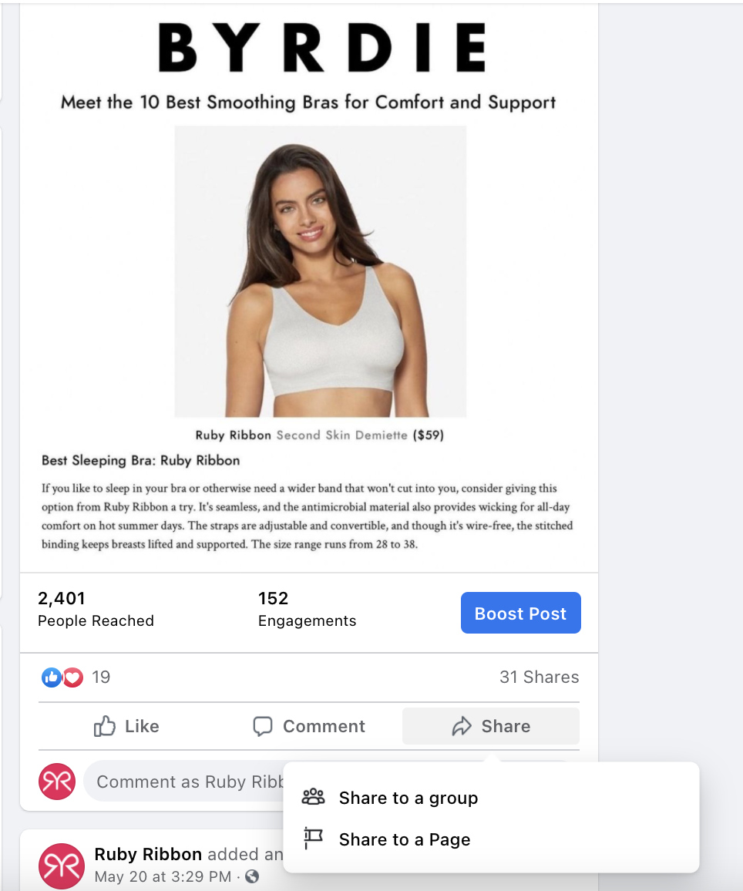
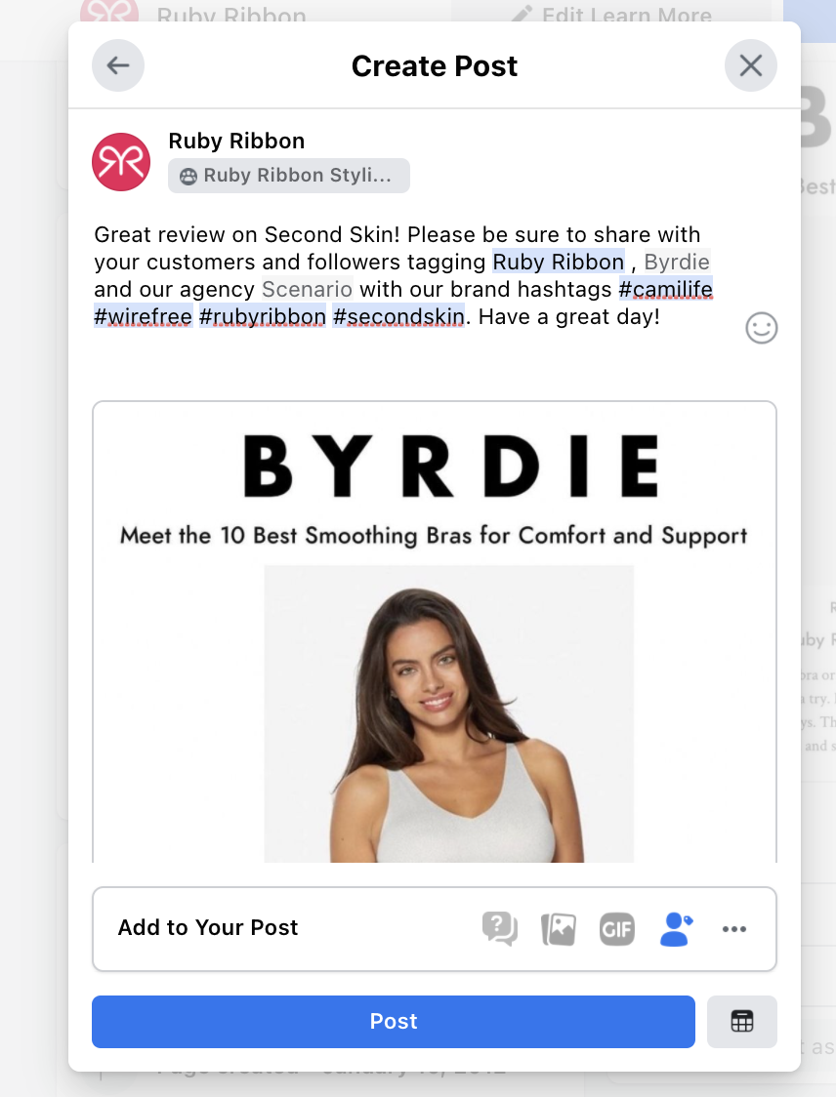
Facebook Guidelines Example
Share corporate post directly using ‘share’ feature, with the option to write a personalized note to your following.

Slide 13
Instagram Guidelines
DO
Use corporate provided assets and messaging
Share corporate social post directly, or take screenshot and copy messaging to use on personal feed.
Tag @rubyribbonhq in post copy.
Tag @<press outlet> in post copy.
Quote directly from the press mention, adding your own flair to the messaging to encourage follower feedback.
Use hashtags relevant to post and brand.
Include specific product name and how to order on your website.
DO NOT
Include "claims" that cannot be made (e.g. no doctoring of press or celebrity testimonials), and additions/alterations that cannot be made.
Miss an opportunity to show on searches by not including hashtags or tagging publications.
Comment with negative feedback. Please contact corporate directly if you have a question or concern.
Add personal font or text over press image given or in RR social post.

Slide 14
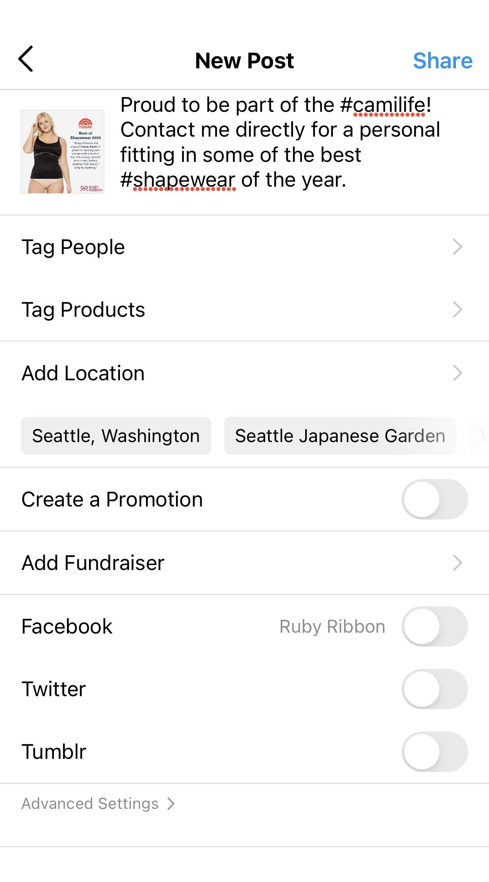
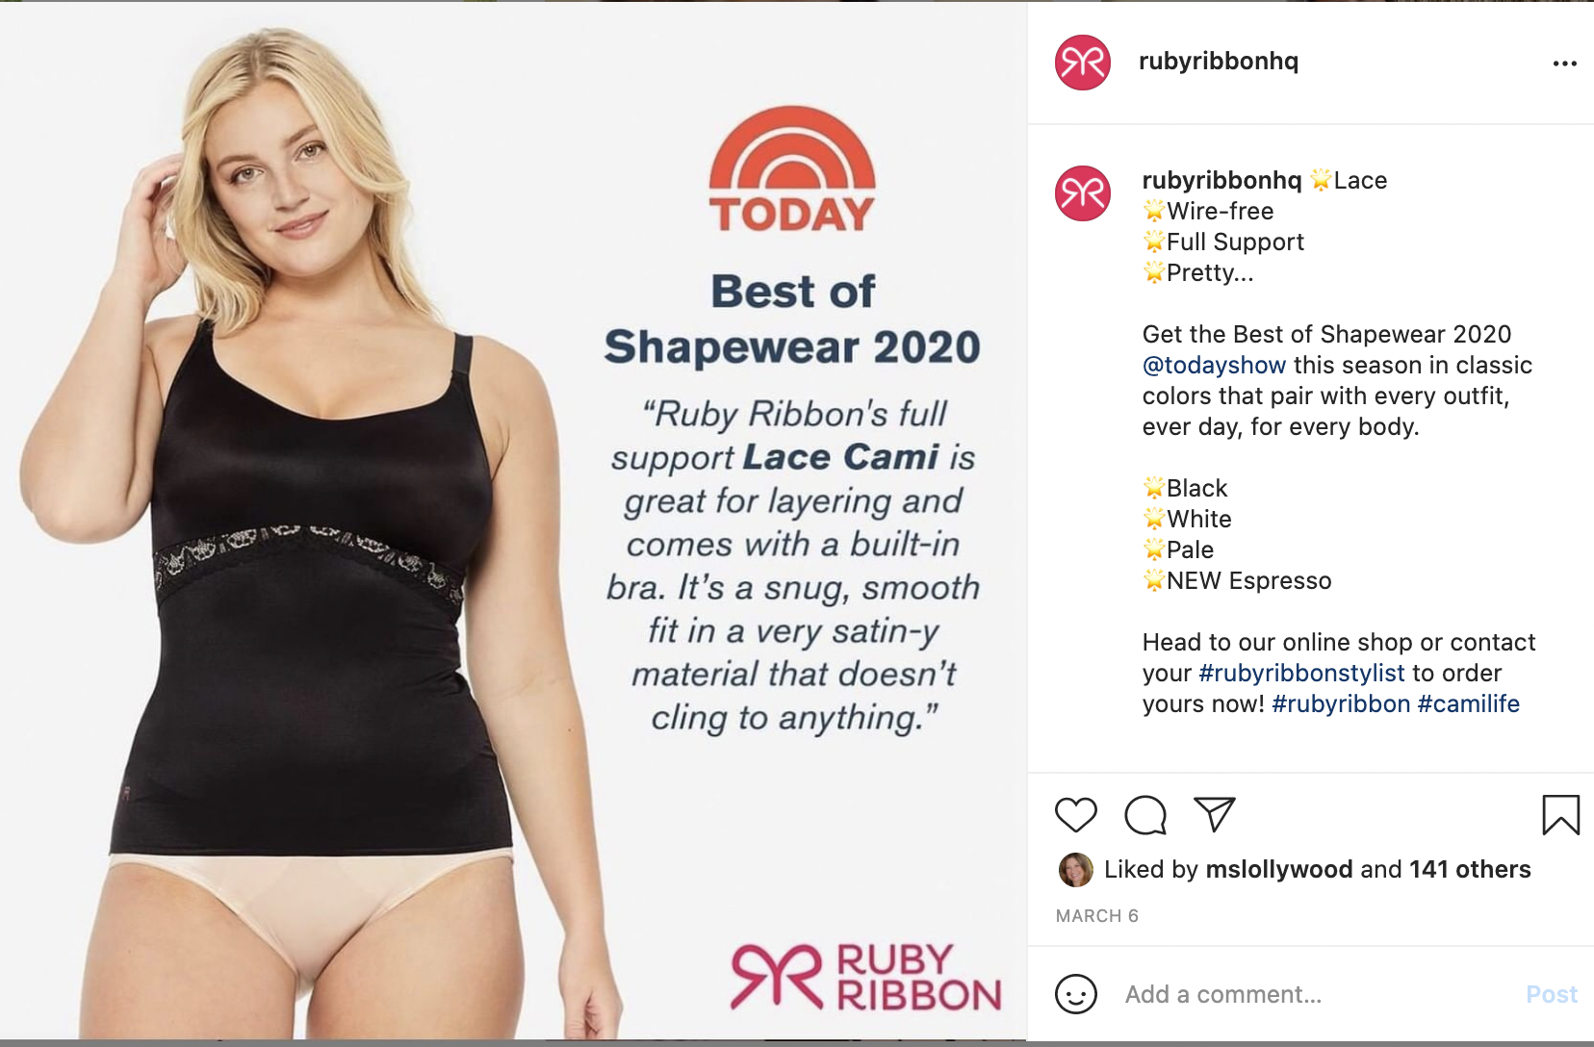
Instagram Guidelines Example
Take a screenshot of corporate post or upload corporate social asset, write a personalized note to your following, and include a #repost with a quote taken directly from the RR corporate feed.

